Slide 1

General Disease Prediction using Machine Learning
INSTITUTE OF ENGINEERING AND TECHNOLOGY, LUCKNOW
Presented by:
Adarsh Gupta (1900520109001)
Jyoti Maurya (1900520109004)
Zainab Israr (1900520109006)
Supervised By:
Mr. Natthan Singh
Dr. Aditi Sharma

Slide 2
Contents
Introduction
Literature Review
Objectives
Motivation
Tools and Technology Used
Methodology
Result
Future Scope
Conclusion
References

Slide 3
Introduction
Good healthcare is one of the most important factor, as the quality of life of people relies explicitly on it.
Mostly people ignore about the general disease in early stage which results in harmful disease later. The most reason for ignorance is laziness to consult a doctor and time concern.
The identification of the disease in the initial stage is important for the prevention of any unwanted casualties.
The project “General Disease Prediction using Machine Learning” is developed to predict general disease.

Slide 4
Literature Review
Pahulpreet Singh Kohli, Shriya Arora (2018) present their work as “Application of Machine Learning in Disease Prediction”. In this paper, they have applied different classification algorithms (Logistic Regression, Decision Tree, Support Vector Machine, Random Forest), on three separate databases of disease (Heart, Breast cancer, Diabetes) for disease prediction. The results of the study strengthen the idea of the application of machine learning in early detection of diseases
Prof Ektaa Meshram, Dhiraj Dahiwade, Prof. Gajanan Patle (2019) proposed their work as “DESIGNING DISEASE PREDICTION MODEL USING MACHINE LEARNING Approach”. There they used two algorithms (K-Nearest and CNN) to work on their project. The accuracy of CNN was found to be 84.5% which was more than KNN algorithm. The memory and time requirement was found to be more in KNN as compared to CNN. [2]
Nikita Pawar, Pooja Sonawane, Narendra Gawai (2020) made a web-based application named “DECISION TREE BASED HEALTH PREDICTION SYSTEM”. [3]

Slide 5
Objective
PROBLEM STATEMENT
To provide quick and accurate disease prediction to the patients.
Identify the health-related issues at an early stage.
CHALLENGES
To choose best possible Algorithms.
To Integrate Model with Web-App.
GOAL
High accuracy in predicting the diseases.
User friendly web application.

Slide 6
MOTIVATION
Less availability of healthcare in rural areas.
Distance of Health centres or Hospitals is too far from patient.
Unavailability of doctors.
Ignorance about the general disease which results in harmful disease later on

Slide 7
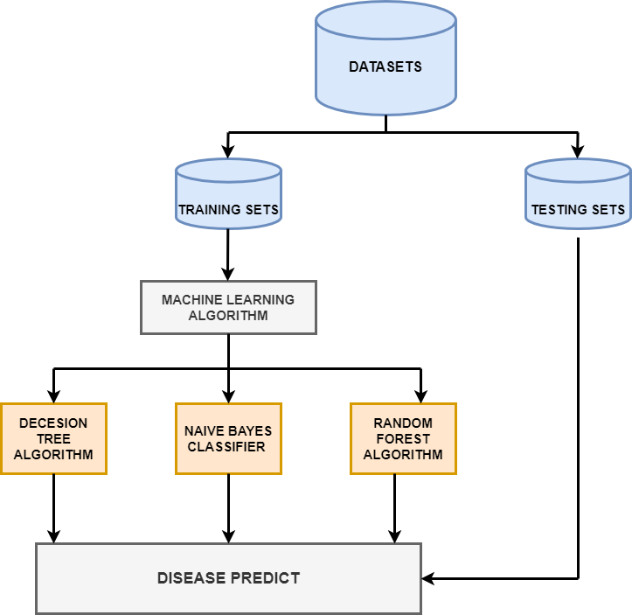
METHODOLOGY
Fig: System Architecture

Slide 8
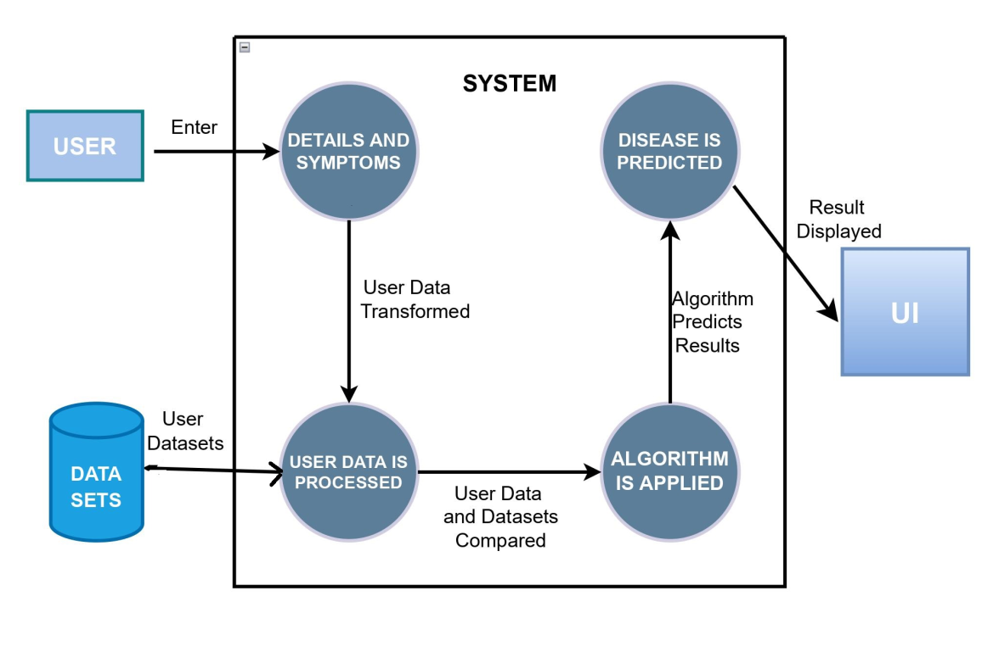
Data Flow Diagram(DFD)
Fig: DFD(Level-1)

Slide 9
Methodology
We have solved the problem of General Disease Prediction using three different algorithms to give accurate result.
The algorithms used to train the model are:
Decision Tree Algorithm
Naive Baye’s Classifier
Random Forest Algorithm

Slide 10
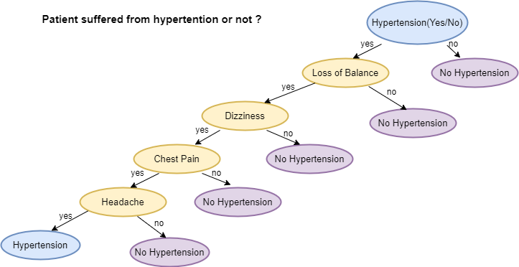
Decision Tree Algorithm
The decision tree learning is a tree like structure to show the predictions that result from a series of features-based splits.
In the beginning, the whole training set is considered as the root.
On the basis of attribute values records are distributed recursively .

Slide 11
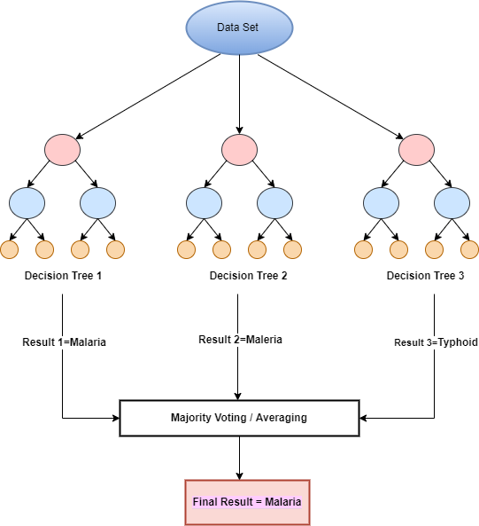
Random Forest Algorithm
Random forest is a classifier that contains a number of decision trees on various subsets of the given dataset and takes the average to improve the predictive accuracy of the dataset.
Random Forest working steps:
Step-1: Select the symptoms
from the training dataset.
Step-2: Construct multiple decision trees
associated with the symptoms.
Step 3: Each decision tree will generate
an output which is a disease.
Step 4: Final output is considered based on
majority voting.

Slide 12
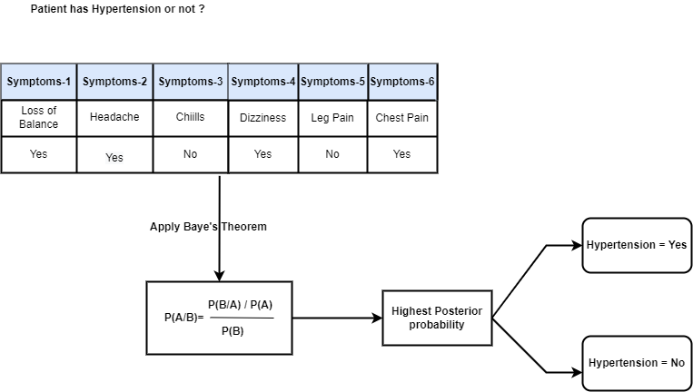
Naive Bayes Classifier
It is supervised machine learning model used for classification task.
It uses a probabilistic model by determining probabilities of the outcomes/outputs.
Working of Naive Baye’s can be explained as:
1. It converts the given dataset into frequency tables.
2. Generate Likelihood table by finding the probabilities of given features.
3. Now, use Baye’s theorem to calculate the posterior probability for each class. The class with the highest posterior probability is the outcome of prediction.

Slide 13
Tools and Technology Used
PYTHON
Python is interpreted, high-level, object-oriented programming language with dynamic semantics.
Jupyter Notebook
It is an open source web application that can be used to create and share documents that contain live code, equations, visualizations, along with explanatory text in a single document.
PyCharm
PyCharm is an integrated development environment (IDE) used in computer programming, specifically for the Python programming language.
Django
It is a high-level web framework that enables rapid development of secure and maintainable websites.
Kaggle
We have collected the dataset from kaggle.
HTML, CSS and Javascript
MySql

Slide 14
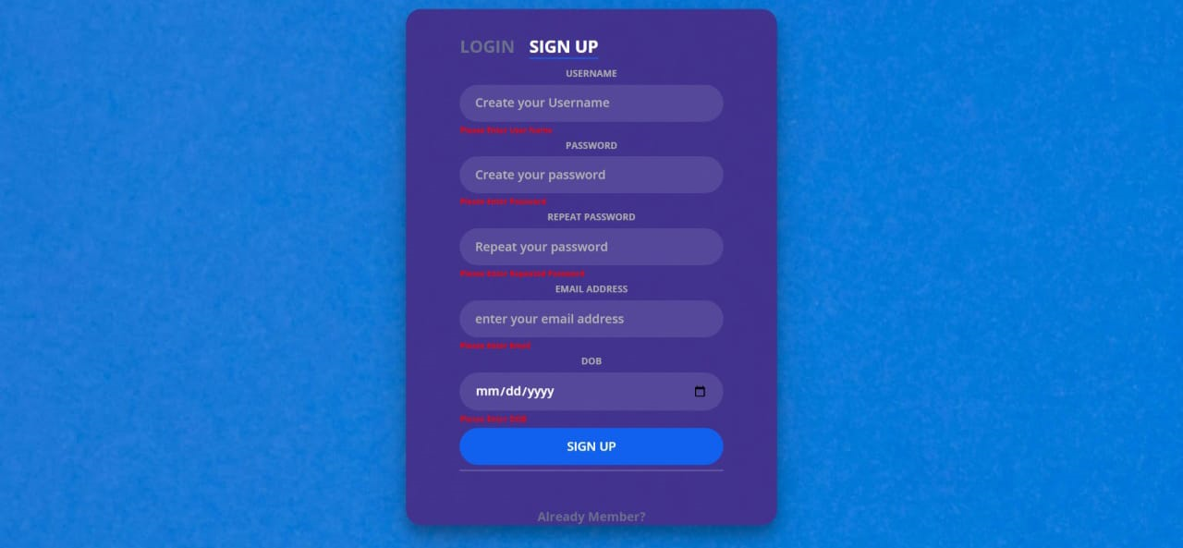
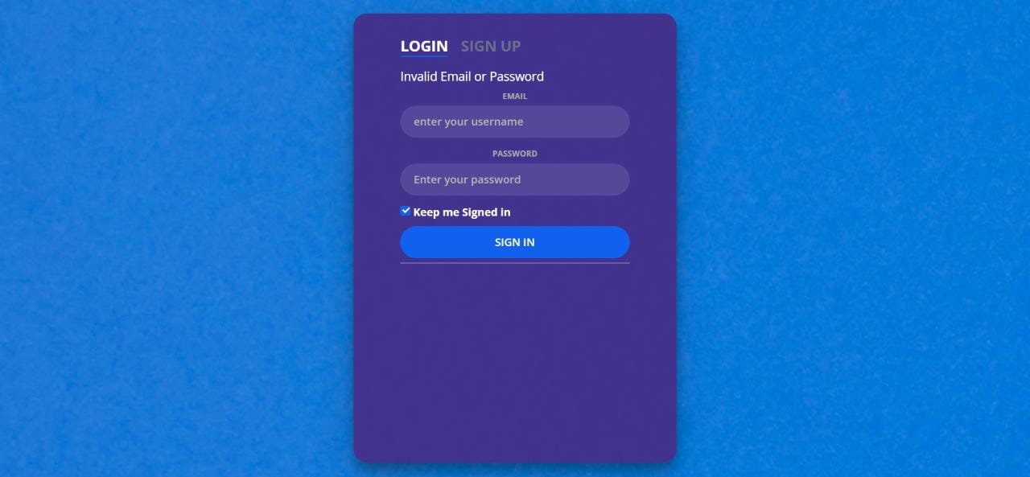
Results(Register and Login Page)
Fig 1: Registration Page
Fig 2: Login Page

Slide 15
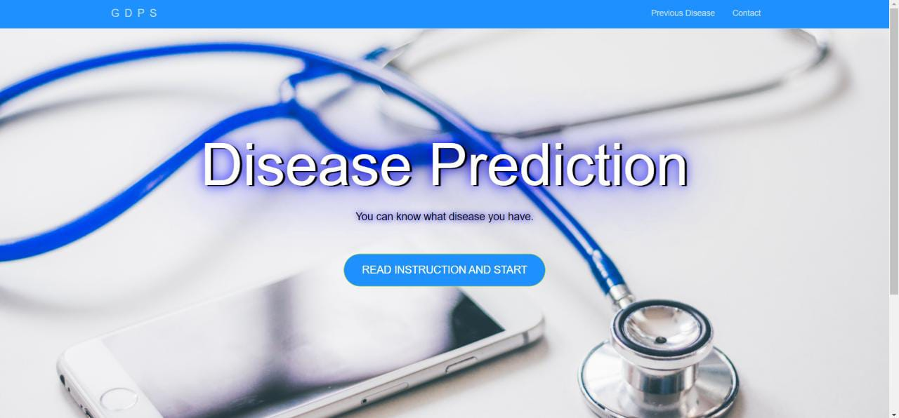
Results(Dashboard)
Fig 3: Dashboard

Slide 16
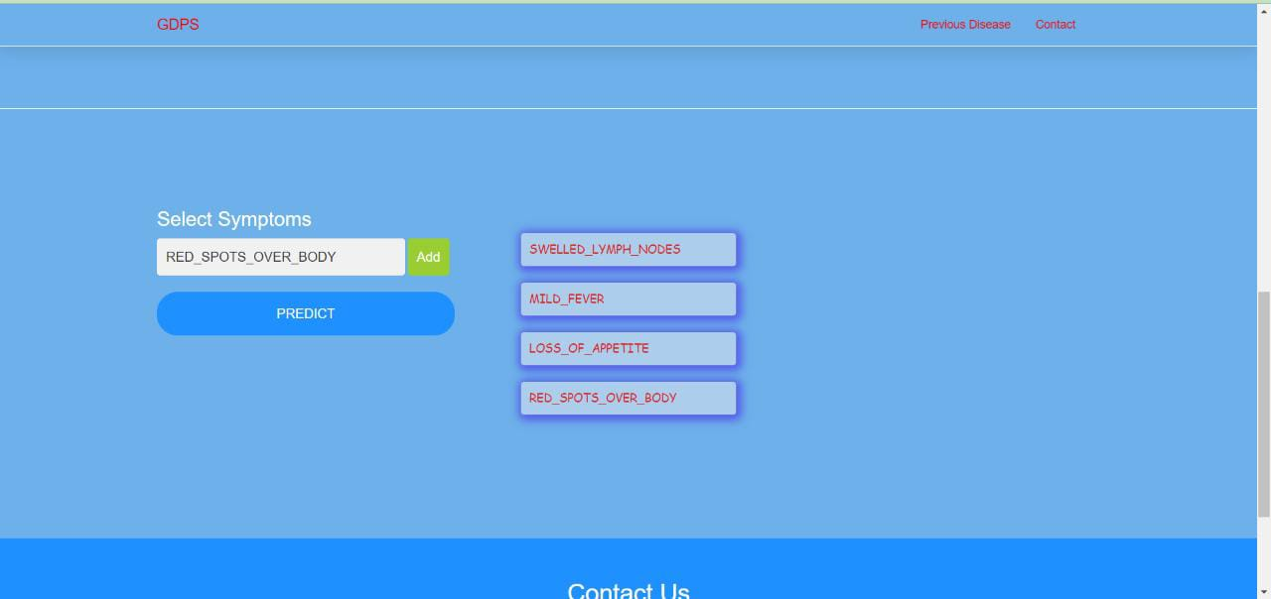
Results(Selecting Symptoms)
Fig 4: Selection of symptoms by user

Slide 17
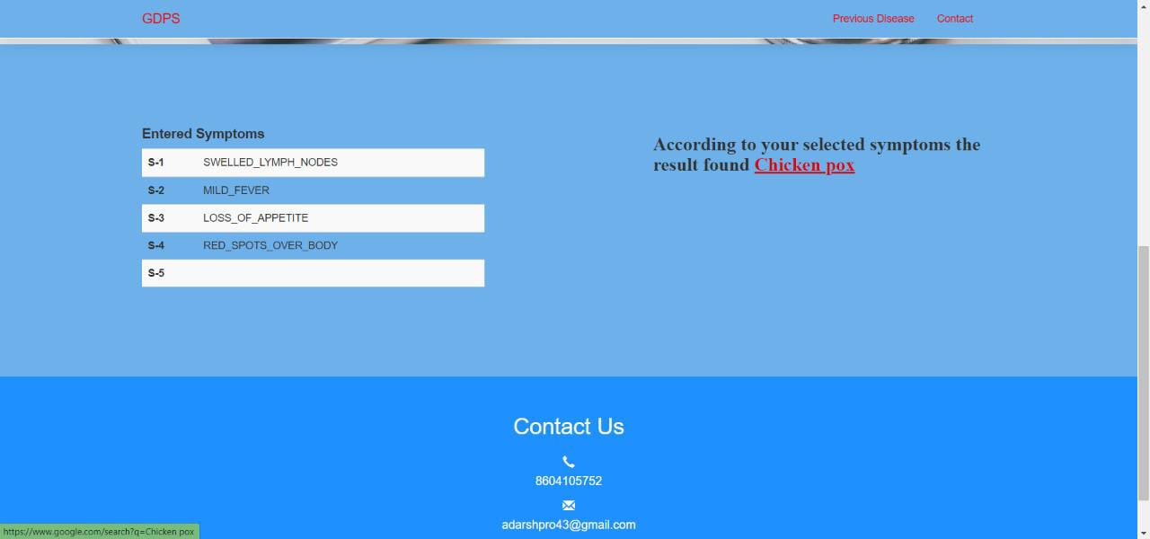
Results(Predicted Output)
Fig 4: Predicted Output

Slide 18
Conclusion
The health industry plays major role in curing diseases of the patients so this application will provide some help to the health sectors and also it will be useful for the user in case they wouldn’t be able to reach to the hospital or any other clinic.
Just only entering symptoms, the user will get to know about the disease they are suffering from.
User can access this system with help of internet at any time.

Slide 19
Future Scope
We can add doctors module from where the patient can get the information of the doctor and can directly contact him for medication.
More details and latest diseases.
Can be converted into Mobile Application.

Slide 20
References
[1] Pahulpreet Singh Kohli, Shriya Arora, “APPLICATION OF MACHINE LEARNING IN DISEASE PREDICTION”, 4th International Conference on Computing Communication and Automation (ICCCA), IEEE, 2018.
[2] Dhiraj Dahiwade, Prof. Gajanan Patle, Prof Ektaa “DESIGNING DISEASE PREDICTION MODEL USING MACHINE LEARNING APPROACH”, Proceedings of the Third International Conference on Computing Methodologies and Communication (ICCMC 2019), IEEE, 2019.
[3] Nishant Yede , Ritik Koul , Chetan Harde , Kumar Gaurav , Prof. C.S.Pagar,” GENERAL DISEASE PREDICTION BASED ON SYMPTOMS PROVIDED BY PATIENT”, Open Access International Journal of Science and Engineering,2021.
Dataset
https://www.kaggle.com/kaushil268/disease-prediction-using-machine-learning

Slide 21
Thank You

